Slide 2
From Print to Digital Toolkit
Key questions and considerations
Action steps
Tools and resources
Helpful hints
Best practices
Quotes

Slide 3
Rationale
Provide guidance to administrators and educators in the selection of quality instructional materials
Establish or enhance state level review processes
Provide guidance to districts

Slide 4
Project Background
Taskforce of state and district leaders and private sector partners
In-person focus groups
Interviews with states
Online collaboration
Independent research
External Reviewers: CCSSO, SIMRA, CAST

Slide 5
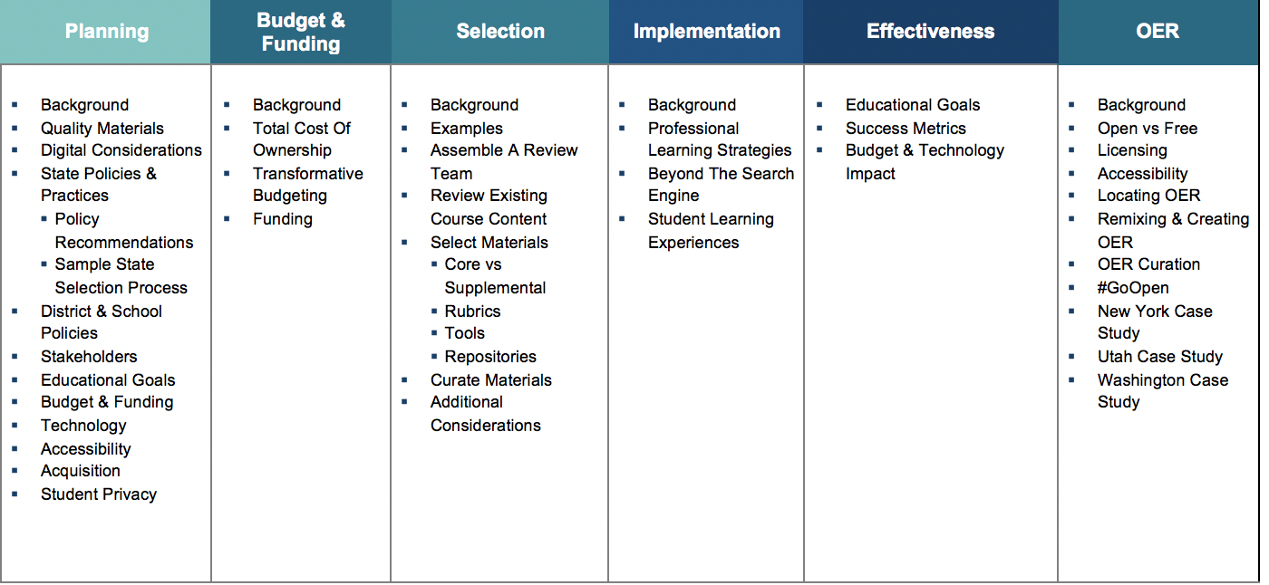
Site Overview

Slide 6
Home Page
Top Navigation
Major Topic Areas

Slide 7
Resources Bank
Select Topic
Resources are Tagged

Slide 8
Essential Question
How do districts and schools select quality instructional materials that are:
Aligned to standards
Address educational goals
Accessible for all students

Slide 9
Key Steps in the Process
Planning
Budget & Funding
Selection
Implementation
Effectiveness
Implementation

Slide 10
Background
Includes action steps for each topic
Subtopics in left navigation

Slide 11
Subtopics
Strategies
Resources
Quotes

Slide 12
Videos
Showcasing Student Learning with Videos

Slide 13
Continue the Conversation
Join the online community
Essential Elements for Digital Content
http://www.edweb.net/digitalcontent
Follow @SETDA on Twitter

